Slide 1

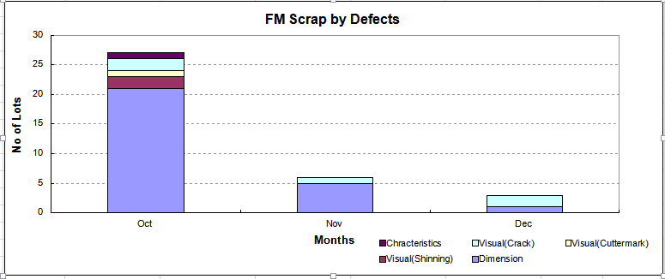
FOREIGN WORKERS HIRING
Subject : Foreign Workers selection
Country : Indonesia (Kebumen - Jogjakarta)
Venue : Balai Latihan Kerja, Dinas Tenaga Kerja, Kabupaten Kebumen
Date : 19/09/2019 ~ 21/09/2019
Interviewer : Shahrudin & Seeni
Details of Selection
1. 105 pax Female candidates interviewed
2. 63 pax candidates selected a) Passport Ready - 31 pax
b) Passport In-Progress - 14 pax
3 . All selected candidates going for repeat medical check-up to ensure no issue on
previous medical check-up done.
4. Passport in-progress and medical check-up report shall be completed between
23/09/19 ~ 27/09/19.
5. On-line key-in shall started after receiving the passport & medical report.

